Slide 1

INTELLIGENT BATTERY MANAGEMENT SYSTEM FOR SOFTWARE-DEFINED EVS
RTOS Project Review-1
Wednesday, August 12th, 2026
 | Under the Guidance of Dr. Srikanth Cherukuvada Assistant Professor, Department of Computer Science and Engineering, KLH CSE Bowrampet Campus
Team Members B.Srihitha 2420030099 R.L.S.Giridhar 2420030171 P.Satwika Reddy 2420030172

Slide 2
Outline of Research Work
Focus
Introduction
Literature Survey
Challenges
Research Objectives
Conclusion & Future Work
References
Publications Details

Slide 3
Problem Statement
EV battery packs require continuous monitoring of voltage, current, temperature, SOC, and SOH for safe operation. Conventional BMS based on fixed rules may miss early abnormalities, while continuous AI inference adds computational and power overhead. Hence, this project proposes an Intelligent Event-Triggered AI-Based BMS that activates AI only when needed, evaluates battery risks, and enables configurable actions using FreeRTOS, Embedded C, CAN Bus, and TensorFlow Lite.
Motivation :
Improve EV battery safety through early fault detection.
Reduce computational and power overhead by triggering AI only when needed.
Enable adaptive battery monitoring under changing operating conditions.
Convert battery risks into configurable and intelligent vehicle actions.
Support SDV-ready BMS using embedded AI and software-defined control.

Slide 4
Objectives
To develop a real-time Intelligent BMS for monitoring battery parameters such as voltage, current, temperature, SOC, and SOH using Embedded C and FreeRTOS.
To implement Event-Triggered AI Inference, where the Edge-AI model is activated only when the initial screening layer detects suspicious battery behavior.
To design a Two-Level Battery Decision System that combines lightweight real-time screening with AI-based verification for reliable battery-condition assessment.
To develop a Software-Defined Risk Policy that converts the detected battery-risk level into configurable actions such as normal operation, warning, charging restriction, or protection.
To integrate CAN Bus communication for exchanging battery status, alerts, risk information, and control decisions with the vehicle-side controller.
To deploy a lightweight AI model using TensorFlow Lite for Edge-AI-based battery anomaly detection on an embedded platform.
To evaluate the proposed system based on detection accuracy, false alarms, AI inference frequency, response time, and computational/resource overhead.

Slide 5
Literature Survey
Authors | Title of the Paper | Methodology | Inferences | Limitation / Future Work
Li et al. [1] | Battery Fault Diagnosis for Electric Vehicles Based on Voltage Abnormality by Combining the Long Short-Term Memory Neural Network and the Equivalent Circuit Model, IEEE Transactions on Power Electronics, 2021 | • Battery Equivalent Circuit Model (ECM) • LSTM neural network for voltage prediction • Modified Adaptive Boosting for improved diagnosis • Prejudging model to reduce computational time • Early battery failure / thermal runaway warning | • Performs battery fault diagnosis using real-world EV operating data • Can identify potential battery-cell failures and locate cells associated with thermal runaway risk • Combines model-based and data-driven approaches for improved diagnosis. (DOI) | • AI is primarily used for fault diagnosis and prediction rather than deciding when AI inference should be activated • Does not implement our two-level screening → AI verification architecture • Does not provide a software-defined risk-to-action policy • Our approach focuses on intelligent AI activation and configurable BMS responses.
[2] | Artificial Intelligence and IoT based Smart Battery Management System for Electric Vehicle, IEEE Conference Publication | • Artificial Intelligence for battery monitoring • IoT-based battery data monitoring • Smart BMS architecture • Battery parameters are monitored and analyzed for intelligent management | • Demonstrates the integration of AI and IoT with EV BMS • Shows the feasibility of intelligent and connected battery management. (IEEE Xplore) | • Focuses on AI + IoT integration rather than event-triggered AI execution • Does not implement our two-level decision mechanism • Does not define a configurable risk-policy layer connecting battery risk to different vehicle actions • Our work focuses on making AI usage and BMS responses adaptive.
Vidal et al. [3] | Machine Learning Applied to Electrified Vehicle Battery State of Charge and State of Health Estimation: State-of-the-Art, IEEE Access, 2020 | • Review of ML-based battery estimation methods • Feedforward Neural Networks (FNN) • Recurrent Neural Networks (RNN/LSTM) • Support Vector Machines (SVM) • RBF and other ML approaches for SOC/SOH estimation | • Provides a comprehensive overview of ML techniques for EV battery SOC and SOH estimation • Demonstrates the increasing use of ML for data-driven battery management. (Directory of Open Access Journals) | • Primarily focuses on battery state estimation, rather than real-time AI-triggering and risk-based BMS decisions • Does not propose our event-triggered inference mechanism • Does not integrate AI output with a software-configurable risk policy • Our project builds a decision architecture around existing lightweight AI models.

Slide 6
Research Gap Identification
Existing Research / Approach | Research Gap Identified | Our Proposed Solution
1. Continuous AI-Based Battery Monitoring – Existing AI-based BMS approaches use ML/DL models such as LSTM, Transformer, Autoencoder, and other models for continuous battery state estimation and anomaly detection. | Continuous execution of AI models can cause unnecessary computational, memory, and energy overhead, particularly on resource-constrained embedded BMS platforms. Existing approaches mainly focus on improving model accuracy rather than deciding when AI inference is actually required. | Event-Triggered AI Inference – A lightweight screening mechanism continuously monitors battery parameters and activates the AI model only when suspicious battery behavior is detected, reducing unnecessary AI inference.
2. Direct AI-Based Battery Decision Making – Many existing systems process battery parameters through an ML/DL model and directly generate a prediction or fault classification. | There is limited separation between fast real-time safety monitoring and computationally intensive AI-based verification. A temporary abnormal reading may also be incorrectly treated as a persistent fault if temporal behavior is not considered. | Two-Level Battery Decision System – Level 1 performs fast screening using battery parameters and trends, while Level 2 activates AI for detailed verification before generating the final battery-risk state.
3. Fixed BMS Control / Response Strategies – Conventional BMS systems generally associate predefined thresholds or detected faults with fixed responses such as warning or protection. | Fixed responses provide limited software flexibility and adaptability for different battery conditions, operating modes, and Software-Defined Vehicle requirements. The connection between AI-derived battery risk and configurable vehicle-level actions is not sufficiently addressed. | Software-Defined Risk Policy – The detected battery risk is passed to a configurable software policy that dynamically determines actions such as normal operation, warning, charging restriction, power limitation, or critical protection.

Slide 7
Novelty
Event-Triggered AI Inference: The proposed BMS continuously monitors battery parameters using a lightweight screening mechanism and triggers the AI model only when suspicious battery behavior is detected. This reduces unnecessary AI computation while maintaining intelligent anomaly detection.
Two-Level Battery Decision System: The system uses two levels of decision-making: Level 1 performs fast screening of voltage, current, temperature, and SOC trends, while Level 2 uses AI to verify suspicious conditions before determining the battery-risk state.
Software-Defined Risk Policy: Instead of using fixed responses for battery abnormalities, the proposed system converts the detected risk into a configurable software policy. Depending on the risk level, it can generate actions such as normal operation, warning, charging restriction, power limitation, or protection.
Overall Novelty
The project proposes a flexible BMS architecture that combines event-triggered AI, two-level decision-making, and software-configurable risk handling to provide intelligent and adaptive battery management for Software-Defined EVs.

Slide 8
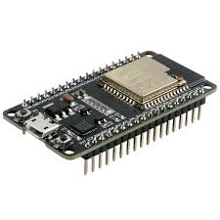
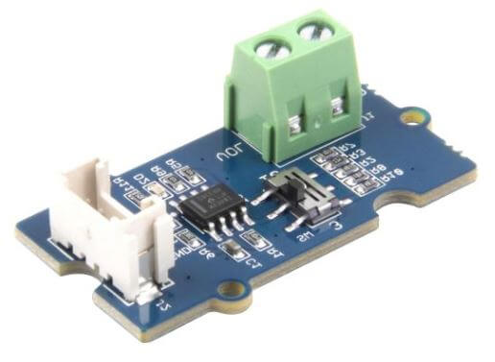
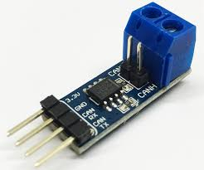
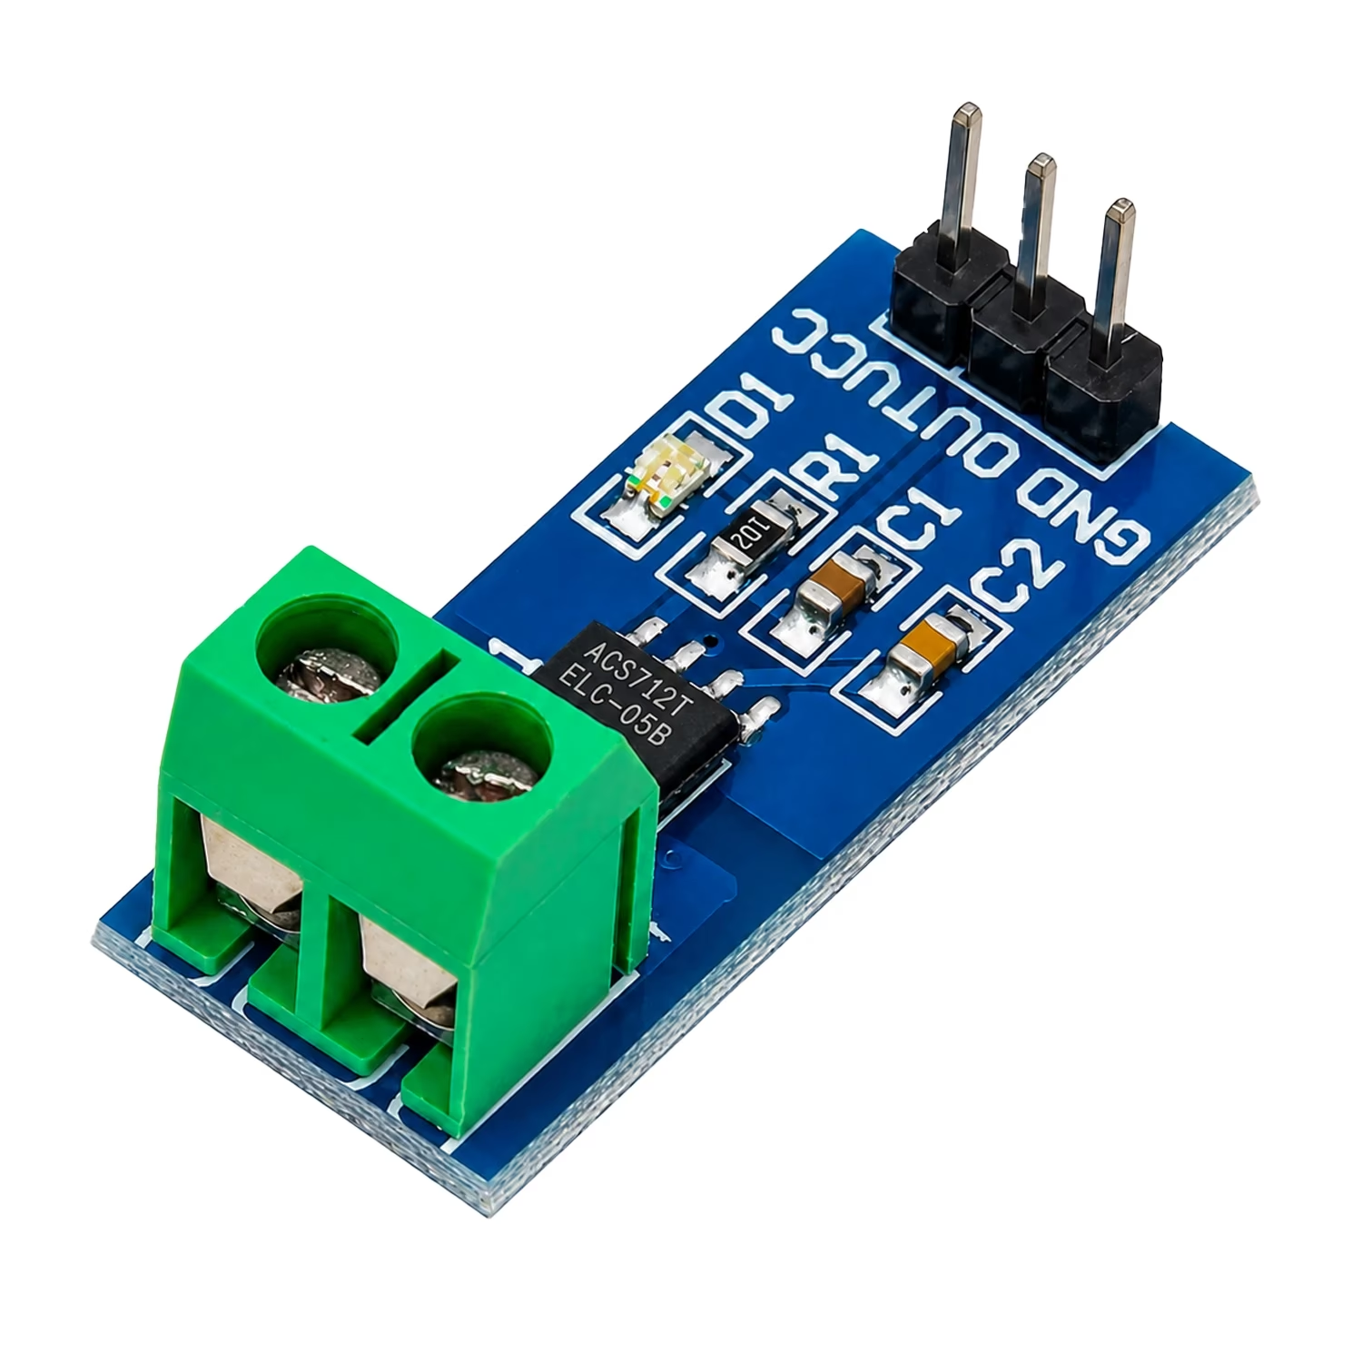
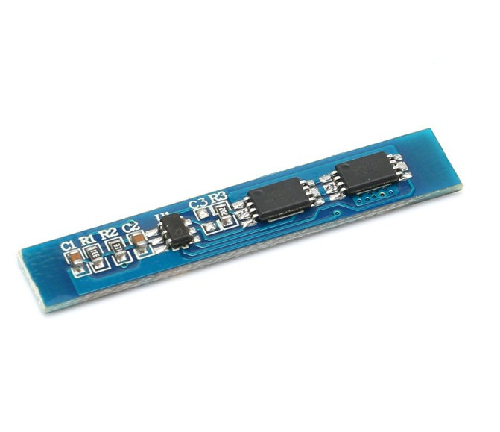

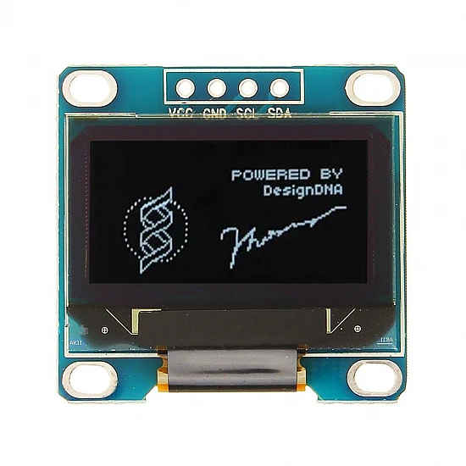
Tech Stack (Hardware)
Component | Suggested choice
Microcontroller | ESP32 DevKit
CAN | SN65HVD230 CAN transceiver
Voltage sensing | Simple resistor voltage divider
Current sensor | ACS712 5A/20A module
Temperature sensor | DS18B20
Battery | 2S/3S protected Li-ion pack OR safer DC battery source
OLED display | 0.96" I²C OLED
Buzzer/LED | Basic modules
MicroSD (optional) | Module + card
Breadboard/wires
ESP32 DevKit
Simple resistor voltage divider
ACS712 5A/20A module
(Current sensor)
SN65HVD230 CAN
transceiver
Temperature sensor
DS18B20
OR safer DC battery source
0.96" I²C OLED

Slide 9
Tech Stack (Software)
Software | Where we use it
Embedded C/C++ | Sensor reading, BMS logic and control algorithms
FreeRTOS | Real-time tasks for sensing, screening, AI inference and CAN communication
TensorFlow Lite / TFLite Micro | Runs the lightweight AI model when suspicious battery behavior is detected
Python | Dataset processing, feature extraction, model training and testing
CAN Protocol | Communication between BMS and vehicle controller
MQTT | Sends battery information from ESP32 to the IoT system
Node-RED | Dashboard, visualization and alerts
SQLite / CSV | Battery data logging
Docker (optional) | Provides a controlled environment for MQTT/Node-RED/Python services

Slide 10
Innovation, Creativity, and Novelty
1. Event-Triggered AI Inference
Existing: AI/advanced processing may run continuously.
Our Approach: AI is triggered only when abnormal battery behavior is detected.
Benefit: Reduces unnecessary computation and improves real-time efficiency.
Flow:
2. Two-Level Battery Decision System
Level 1: Fast screening using thresholds + parameter checks + trend analysis.
Level 2: AI-based verification for suspicious conditions.
Benefit: Faster decisions with lower computational requirements.
Flow:
3. Software-Defined Risk Policy
Converts battery conditions into Low / Medium / High / Critical risk levels.
Uses a configurable software policy to select the appropriate response.
Possible actions:
Normal Operation
Warning / Alert
Charging or Power Limitation
Protection / Shutdown
Flow:
Monitor
Fast Screening
Yes
AI Inference
AI Result
Risk Level
Software Policy
BMS / Vehicle Action
Real-Time Data
Screening
Suspicious?
AI Verification
Risk Assessment

Slide 11
Feasibility
1. Technical Feasibility
The proposed system is technically feasible using Embedded C, FreeRTOS, CAN Bus, and TensorFlow Lite. Battery parameters such as voltage, current, temperature, and SOC can be collected through sensors and processed in real time. A lightweight pre-trained ML model can be deployed using TensorFlow Lite for Edge-AI inference.
2. Economic Feasibility
The project can be implemented using low-cost embedded hardware, sensors, and open-source software tools. Existing ML models can be reused instead of developing a computationally complex model from scratch. Event-triggered inference can also reduce unnecessary computational resource usage.
3. Operational Feasibility
The proposed BMS can continuously monitor battery conditions and provide real-time alerts and decisions. The Two-Level Battery Decision System allows normal conditions to be handled with lightweight processing, while suspicious conditions are verified using AI. The Software-Defined Risk Policy enables battery-management actions to be configured through software.
4. Integration Feasibility
The system can be integrated with the EV control architecture using CAN Bus. FreeRTOS can manage sensing, monitoring, AI inference, communication, and safety tasks as separate real-time tasks. IoT and Docker can additionally be used for data logging, visualization, and analysis.
5. Overall Feasibility
The proposed project is feasible because it combines existing, well-established technologies in a new BMS architecture. The major contribution lies in the integration of Event-Triggered AI Inference, Two-Level Battery Decision System, and Software-Defined Risk Policy for intelligent and adaptable battery management.

Slide 12
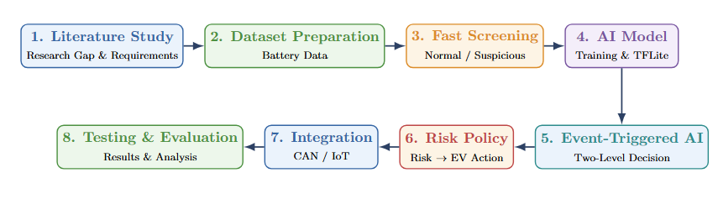
Project Plan
Phase | Activity | Output
1 | Literature Study & Requirements | Research gap & requirements
2 | Dataset Preparation | Clean battery dataset
3 | Fast Screening | Normal/Suspicious detection
4 | AI Model Development | Lightweight AI model
5 | Event-Triggered AI + Two-Level Decision | Intelligent decision system
6 | Risk Policy & CAN/IoT | Risk-based EV actions
7 | Testing & Evaluation | Accuracy, response time & AI usage
8 | Documentation & Presentation | Final report & demo

